Slide 1

THE|PATHFINDERS
{ TAN JEREMY | LEOW BRYAN | LIM SHI HAN}
{ FSP 5, TEAM 7 }
Blazing new trails
USING AI

Slide 2
DATA ANALYTIC PIPELINE
INTRODUCTION
DATA WRANGLING, EXPLORATION
MACHINE LEARNING
CONCLUSION
Dataset Used
Problem Definition
Data Collection, Curation and Preparation
Exploratory Data Analysis
Time-series Forecasting
Regression
Outcome
Data-driven Insights
Notes:
10% for coming up with an interesting problem based on your dataset​
10% for data extraction, curation and/or joining based on the problem​
10% for data preparation and cleaning to suit the problem of your choice​
10% for exploratory data analysis/visualization to gather relevant insights​
10% for the use of machine learning techniques to solve specific problem​
10% for the presentation of data-driven insights and recommendations​
10% for the quality of final presentation (video) and overall impression​
10% for learning something new and trying something beyond the course​

Slide 3


INTRODUCTION
Dataset Used | Problem Definition

Slide 4


DATASET
USED
DATASET 4
Land Transport DataMall Datasets and APIs

Slide 5
PROBLEM
DEFINITION
Where should new MRT/bus stops be built to alleviate traffic?

Slide 6
PROBLEM
DEFINITION
Where should new MRT/bus stops be built to alleviate traffic?
1. What are the characteristics of a busy stop?

Slide 7
PROBLEM
DEFINITION
Where should new MRT/bus stops be built to alleviate traffic?
1. What are the characteristics of a busy stop?
2. Which places in Singapore are forecasted to exhibit these characteristics in the future?

Slide 8
DATA WRANGLING
Data Collection, Curation, and Preparation

Slide 9
DATA
COLLECTION
1/3
Learnt how to use Postman agent to make API calls to the LTA DataMall API [DC1], to obtain tap in and tap out information for buses and MRTs from the last 3 months.
Information | Name of file
Tap in and tap out information for buses and MRTs from the last 3 months. Via Postman agent[1] | Download using postman agent: http://datamall2.mytransport.sg/ltaodataservice/PV/Bus http://datamall2.mytransport.sg/ltaodataservice/PV/Train 2.5_transport_node_bus_202101.csv 2.5_transport_node_bus_202102.csv 2.5_transport_node_bus_202103.csv 2.8_transport_node_train_202101.csv 2.8_transport_node_train_202102.csv 2.8_transport_node_train_202103csv

Slide 10
DATA
COLLECTION
2/3
Next, we downloaded shapefiles for the location of Singapore’s bus stops and MRT stations.
Information | Name of file
Shapefile for the location of Singapore bus stops and MRT stations | Download: https://datamall.lta.gov.sg/content/dam/datamall/datasets/Geospatial/BusStopLocation.zip BusStop.cpg, BusStop.dbf, BusStop.prj, BusStop.sbn BusStop.sbx, BusStop.shp, BusStop.shp.xml, BusStop.shx Download: https://datamall.lta.gov.sg/content/dam/datamall/datasets/Geospatial/TrainStation.zip MRTLRTStnPtt.cpg, MRTLRTStnPtt.dbf, MRTLRTStnPtt.prj, MRTLRTStnPtt.sbn, MRTLRTStnPtt.sbx, MRTLRTStnPtt.shp, MRTLRTStnPtt.shx

Slide 11
DATA
COLLECTION
3/3
And finally, we searched the Internet for the following information, which we found on gov.sg.
Information | Name of file
Shapefile for the location of Singapore bus stops and MRT stations | Download: https://data.gov.sg/dataset/master-plan-2014-subzone-boundary-web?resource_id=1c6b586b-61ca-45a9-b704-df4c9057fbd6
Resident demographics (age group, sex, type of dwelling) by subzone | Download: https://www.singstat.gov.sg/-/media/files/find_data/population/statistical_tables/singapore-residents-by-planning-areasubzone-age-group-sex-and-type-of-dwelling-june-20002020.xlsx singapore-residents-by-planning-areasubzone-age-group-sex-and-type-of-dwelling-june-20002020.xlsx sheets: 2020(Total), 2011-2019(Total)
Monthly household income by dwelling type | Download: https://data.gov.sg/dataset/average-monthly-household-income-from-each-source-by-type-of-dwelling

Slide 12

DATA
PREPARATION
1/6
Dataset #1
demographic data by subzone from 2011 to 2019
Dataset #2
traffic volume in 2021 for the various subzones and their demographics

Slide 13
DATA
PREPARATION
1/6
Dataset #1
demographic data by subzone from 2011 to 2019
Dataset #2
traffic volume in 2021 for the various subzones and their demographics

Slide 14
DATA
PREPARATION
2/6
Learnt how to use Geopandas to read in the stop/station shp files
Learnt concepts of SQL joining to left join stop/station location data with subzone data using Geopandas’ sjoin function.
To extract demographics, we filtered population by subzone, age group, type of dwelling and found the list of subzones.

Slide 15
DATA
PREPARATION
2/6
Learnt how to use Geopandas to read in the stop/station shp files
Learnt concepts of SQL joining to left join stop/station location data with subzone data using Geopandas’ sjoin function.
To extract demographics, we filtered population by subzone, age group, type of dwelling and found the list of subzones.

Slide 16
DATA
PREPARATION
2/8
Learnt how to use Geopandas to read in the stop/station shp files
Learnt concepts of SQL joining to left join stop/station location data with subzone data using Geopandas’ sjoin function.
To extract demographics, we filtered population by subzone, age group, type of dwelling and found the list of subzones.

Slide 17
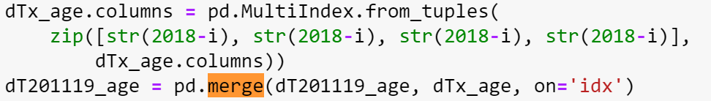
DATA
PREPARATION
3/8
Age group had a problem as it consisted of 19 bins, of which some levels rarely occurred.
Having too many levels will impact model performance[DC2]
Hence we pivoted this data frame to aggregate population into 4 age groups.
To achieve this, we learnt how to use the following commands:
- .pivot() = reshape dataframe by column/index values[DC3]
- . merge() = merge/join datasets[DC4]

Slide 18
DATA
PREPARATION
3/8
Age group had a problem as it consisted of 19 bins, of which some levels rarely occurred.
Having too many levels will impact model performance[DC2]
Hence we pivoted this data frame to aggregate population into 4 age groups.
To achieve this, we learnt how to use the following commands:
- .pivot() = reshape dataframe by column/index values[DC3]
- . merge() = merge/join datasets[DC4]

Slide 19
DATA
PREPARATION
3/8
Age group had a problem as it consisted of 19 bins, of which some levels rarely occurred.
Having too many levels will impact model performance[DC2]
Hence we pivoted this data frame to aggregate population into 4 age groups.
To achieve this, we learnt how to use the following commands:
- .pivot() = reshape dataframe by column/index values[DC3]
- . merge() = merge/join datasets[DC4]

Slide 20
DATA
PREPARATION
3/8
Age group had a problem as it consisted of 19 bins, of which some levels rarely occurred.
Having too many levels will impact model performance[DC2]
Hence we pivoted this data frame to aggregate population into 4 age groups.
To achieve this, we learnt how to use the following commands:
- .pivot() = reshape dataframe by column/index values[DC3]
- . merge() = merge/join datasets [DC4]

Slide 21
DATA
PREPARATION
4/8
We also filtered male and female population from a separate sheet by subzone and represented gender by “male percentage”, male population divided by total population. We chose percentage instead of absolute numbers to reduce the confounding effect [DC5] of total subzone population, and dropped the female category to prevent collinearity. [DC6]
To do this, we learnt the following commands:
- .MultiIndex = allows for hierarchical indexing [DC7]
- .replace() = replace values in columns 1 .insert() = insert value/column to a specified index [DC8]

Slide 22
DATA
PREPARATION
5/8
We calculated average income by subzone. This is to obtain at least one continuous variable in our model. We did this by mapping the type of dwelling to its associated average income, and learnt the following command:
- . loc[] = access group or column by label [DC9]
We left joined hierarchical data for the subzones (such as their Planning Area and Region) and added additional columns that combined these hierarchical info.
- .get_level_values(0) = flatten a hierarchical, multiindex into a single index (to facilitate merging)[DC10]

Slide 23
DATA
PREPARATION
5/8
We calculated average income by subzone. This is to obtain at least one continuous variable in our model. We did this by mapping the type of dwelling to its associated average income, and learnt the following command:
- . loc[] = access group or column by label [DC9]
We left joined hierarchical data for the subzones (such as their Planning Area and Region) and added additional columns that combined these hierarchical info.
- .get_level_values(0) = flatten a hierarchical, multiindex into a single index (to facilitate merging)[DC10]

Slide 24
DATA
PREPARATION
6/8
To conform to time-series data formats, we pivoted the data to make the year a column instead of a multi-indexer, and shifted the corresponding data down the dataframe to achieve unique columns, as shown.
- .concat() = perform the equivalent of SQL’s union[DC11]
- .to_datetime() = coerce a column into datetime64[ns] datatype[DC12]

Slide 25
DATA
PREPARATION
7/8
Dataset #1
demographic data by subzone from 2011 to 2019
Dataset #2
traffic volume in 2021 for the various subzones and their demographics

Slide 26
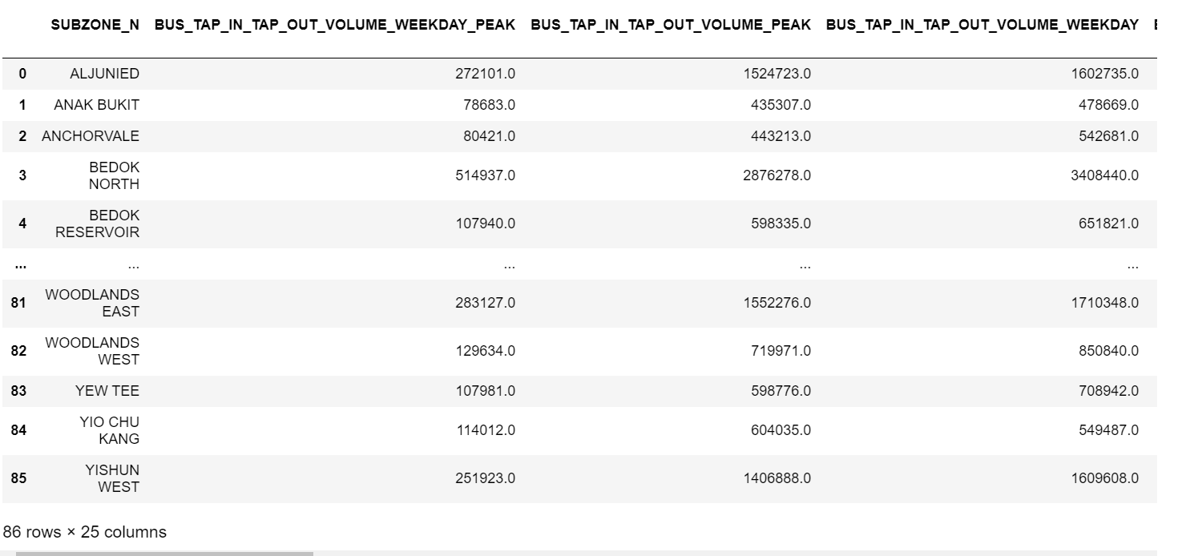
DATA
PREPARATION
8/8
Calculated the peak hour traffic [DC13] and expressed peak hour rate and weekday rates as a percentage of the weekly total
Summed up data for all 3 months and find the average of the three months

Slide 27
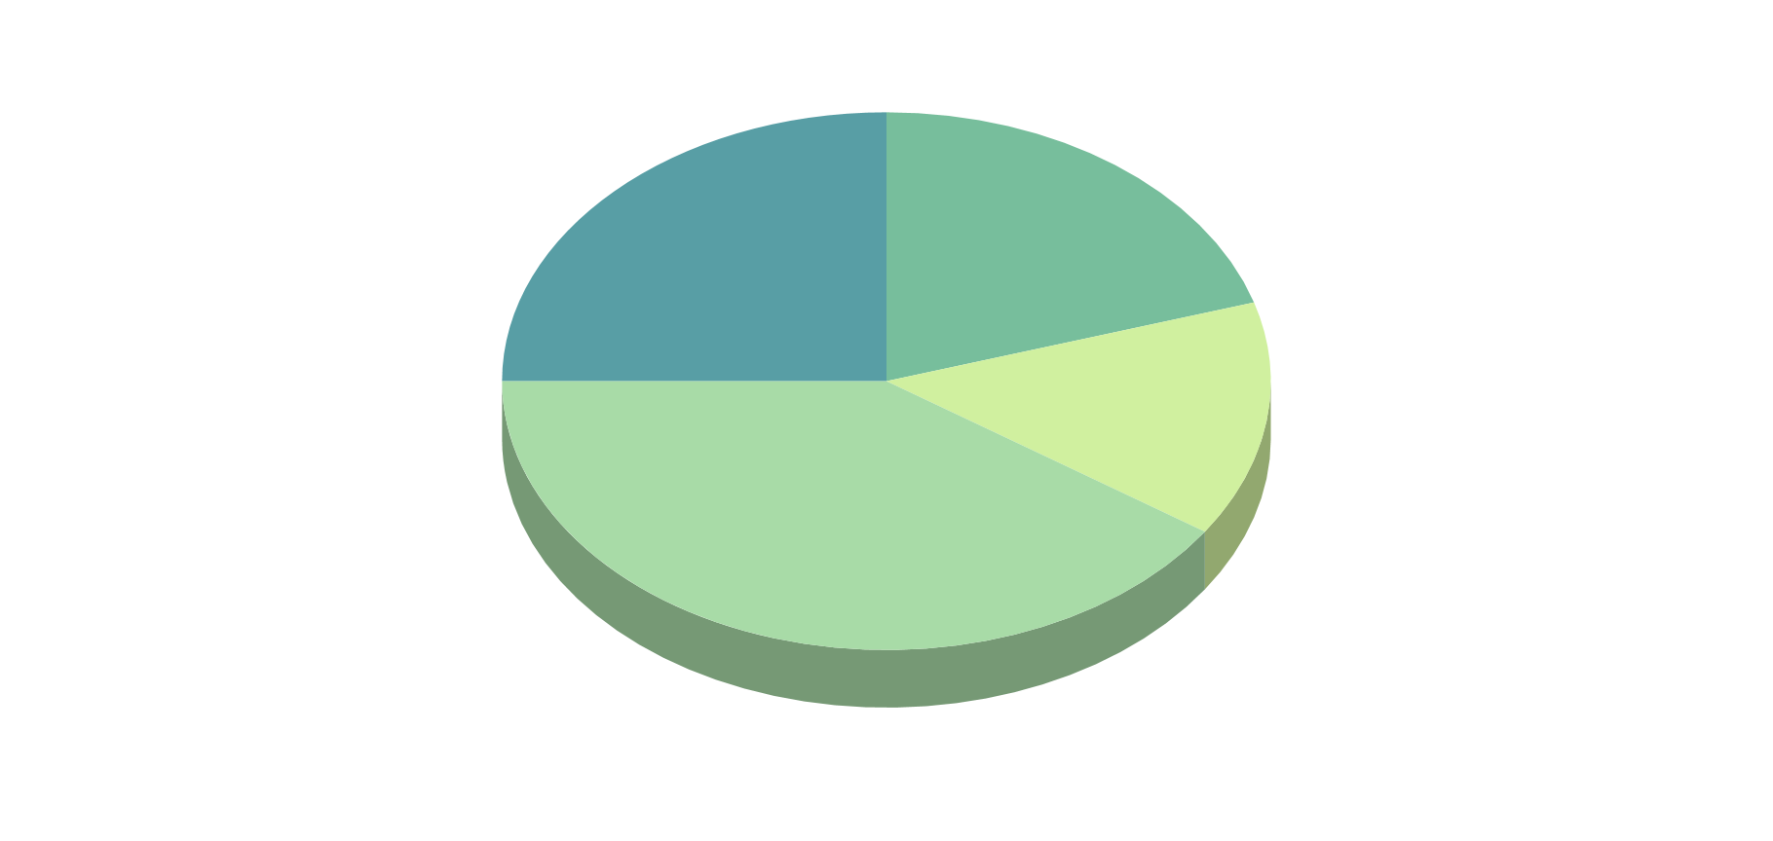
EXPLORATORY DATA
ANALYSIS

Slide 28
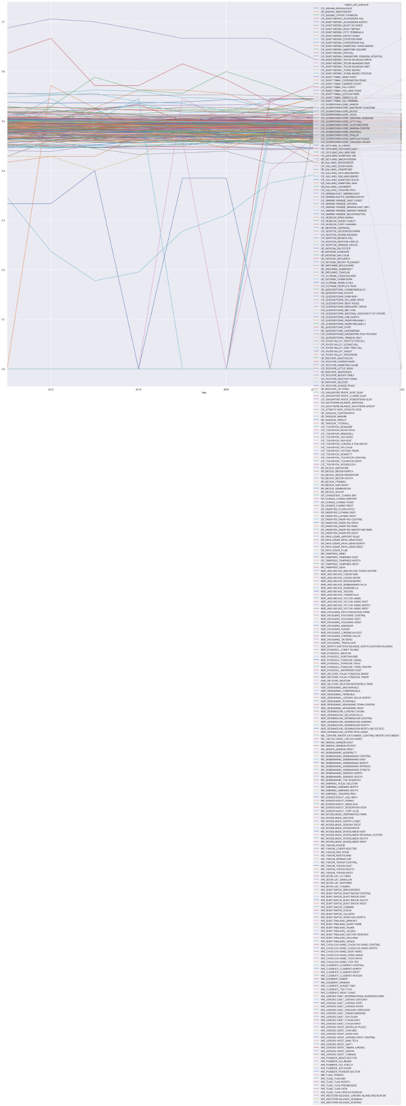
EXPLORATORY
ANALYSIS
1/5
We did a time series analysis on the population demographics

Slide 29
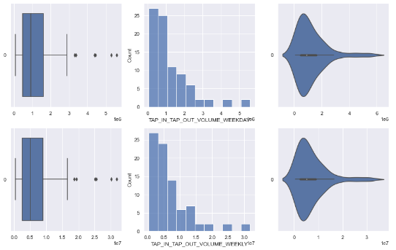
EXPLORATORY
ANALYSIS
2/5
We did a time series analysis on the population demographics
Plot a boxplot, histogram, violin plot and pairplot for the variables

Slide 30
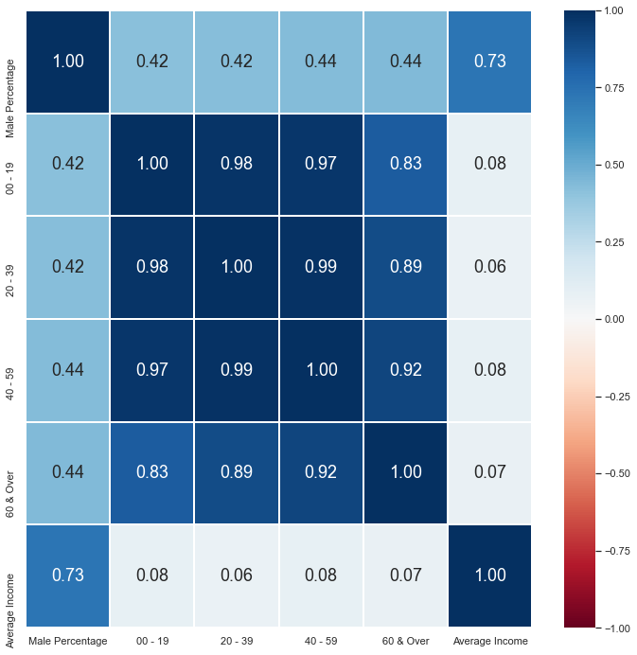
EXPLORATORY
ANALYSIS
3/5
We did a time series analysis on the population demographics
Plot a boxplot, histogram, violin plot and pairplot for the variables
Plot a heatmap to analyse the correlation for each of the variables

Slide 31
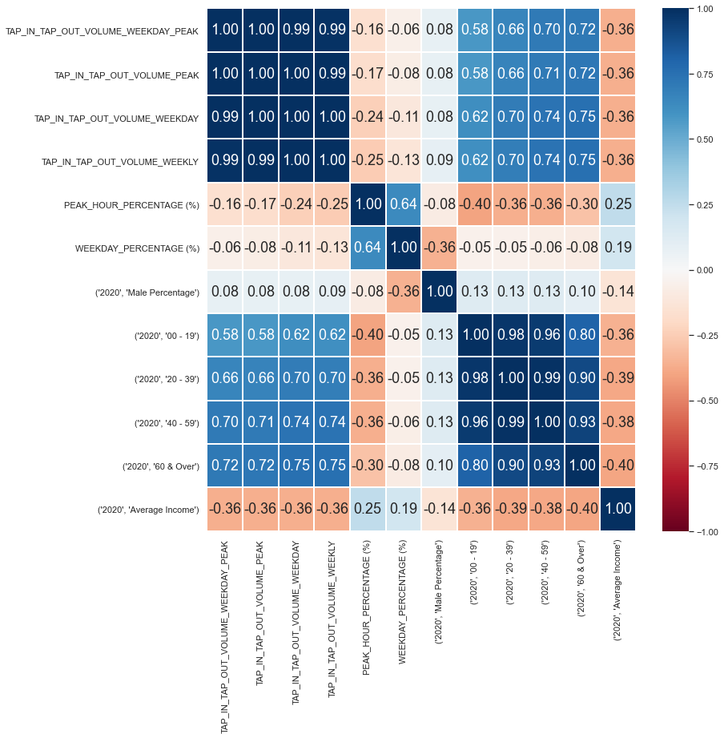
EXPLORATORY
ANALYSIS
4/5
We merged the dataset 1 and 2 together
Plot a boxplot, histogram, violin plot and pairplot for the variables
Plot a heatmap to analyse the correlation for each of the variables

Slide 32
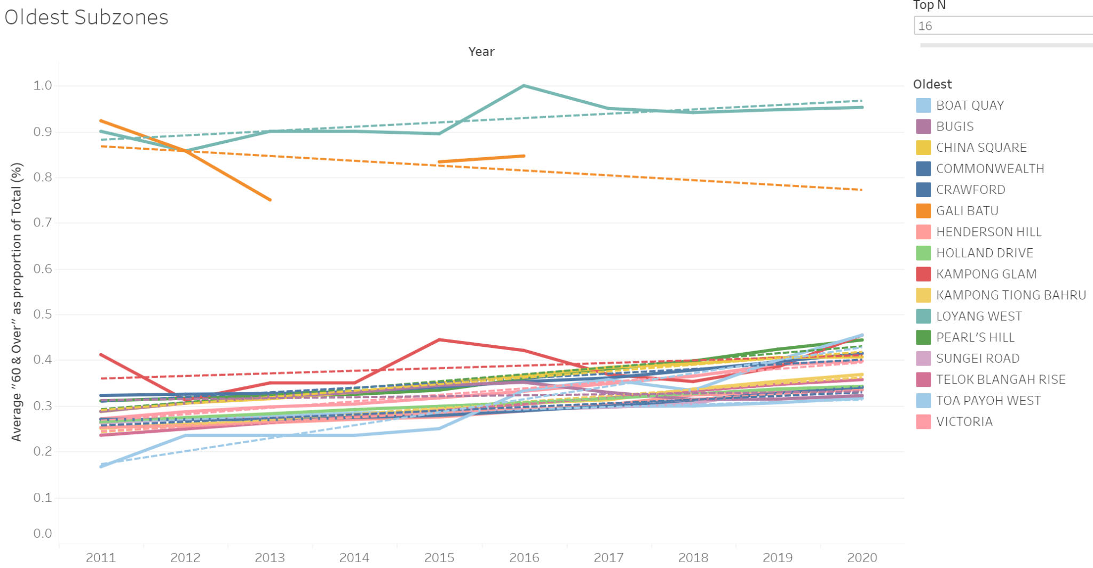
EXPLORATORY
ANALYSIS
5/5
We used Tableau to plot various graph to analyse the population percentage of different age groups, subzones and the tap in tap out rate

Slide 33



MACHINE LEARNING
Time-series | Regression

Slide 34

REGRESSION
traffic = f(demographic & other data)
Problem #1
What are the characteristics of a busy stop?
Dataset #2
traffic volume in 2021 for the various subzones and their demographics
TIME-SERIES
forecast future demographics using past demog. trends
Problem #2
Which places in Singapore are forecasted to exhibit these characteristics in the future?
Dataset #1
demographic data by subzone from 2011 to 2019

Slide 35


TIME-SERIES FORECASTING
1/7
This entire section was learnt beyond the course
AUTOREGRESSION
vs
ARIMA
too little data points to perform Granger’s Causality Test [TS1]
Vector-based (VAR, VARIMA)

Slide 36
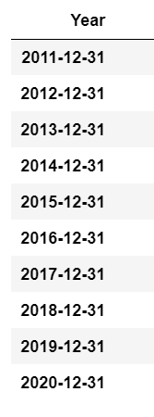
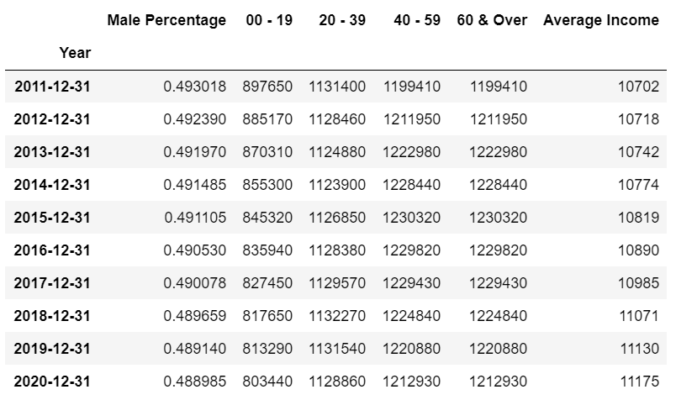
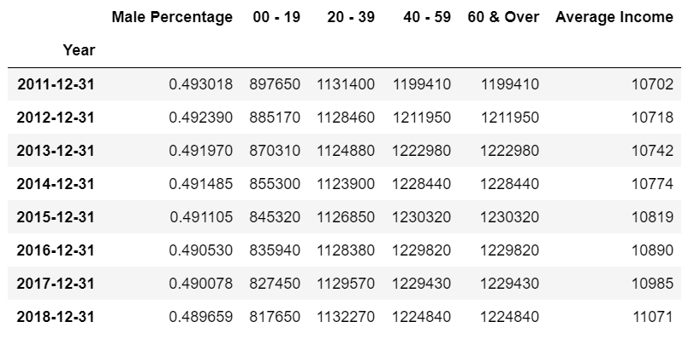
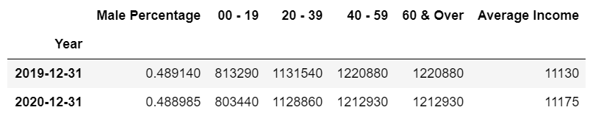
TIME-SERIES FORECASTING
2/7
Set the time series as index [TS2]
Perform a train-test split to ensure backtesting [TS3]
Explore the data column by column, starting with the 0-19 age group.

Slide 37
TIME-SERIES FORECASTING
2/7
Set the time series as index [TS2]
Perform a train-test split to ensure backtesting [TS3]
Explore the data column by column, starting with the 0-19 age group.

Slide 38
TIME-SERIES FORECASTING
2/7
Set the time series as index [TS2]
Perform a train-test split to ensure backtesting [TS3]
Explore the data column by column, starting with the 0-19 age group.

Slide 39
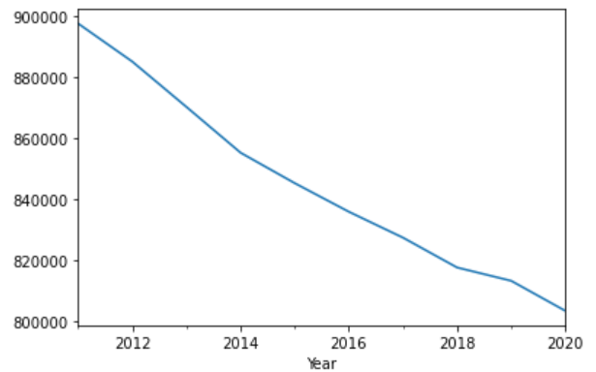
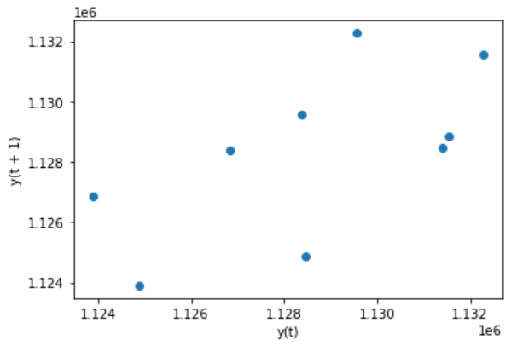
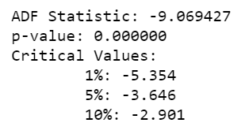
TIME-SERIES FORECASTING
3/7
Determine the existence of autocorrelation, using a lag plot [TS4]
Check for stationarity, using a time-series plot and the Augmented Dickey-Fuller (ADF) test. [TS5]
Since both these stationarity tests returned contradictory results, we decided to go ahead and apply differencing to the variables.

Slide 40
TIME-SERIES FORECASTING
3/7
Determine the existence of autocorrelation, using a lag plot [TS4]
Check for stationarity, using a time-series plot and the Augmented Dickey-Fuller (ADF) test. [TS5]
Since both these stationarity tests returned contradictory results, we decided to go ahead and apply differencing to the variables.

Slide 41
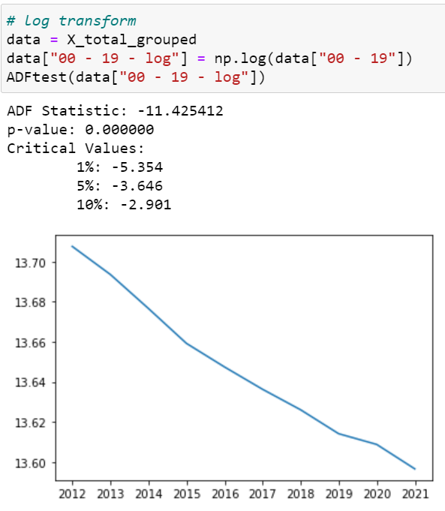
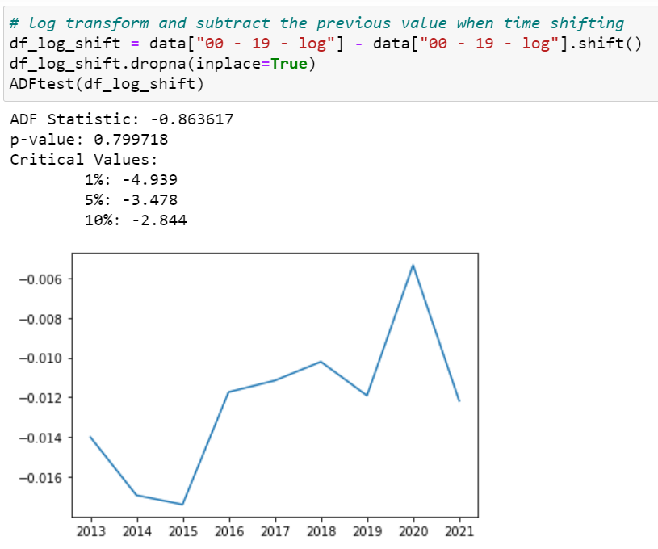
TIME-SERIES FORECASTING
4/7
Choose between logarithmic transformation, log plus differencing [TS6], or not transforming at all, using the ADF score. (Log transform had the lowest ADF for the “00 - 19” variable.)
← log transform
log transform + differencing →

Slide 42
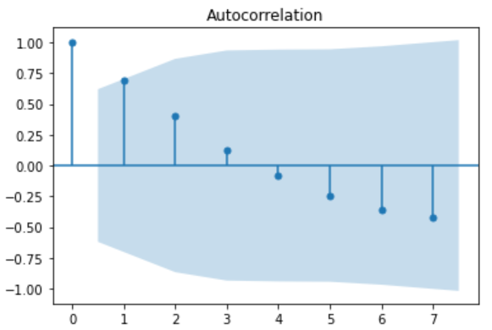
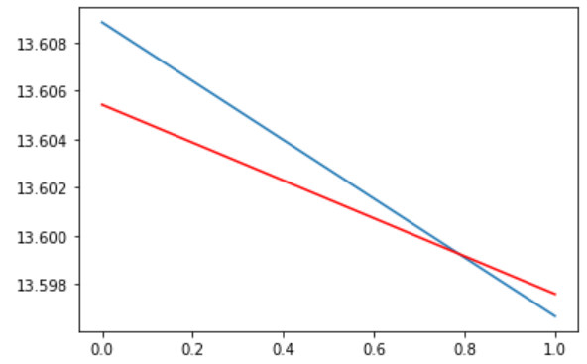
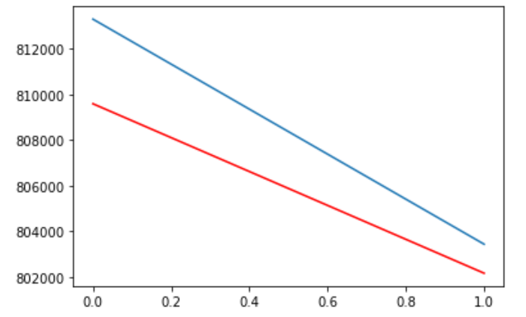
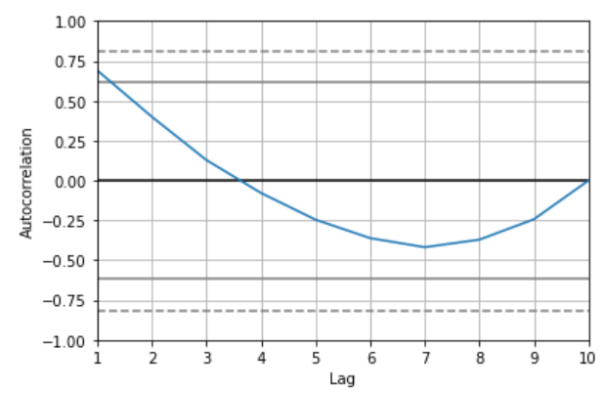
TIME-SERIES FORECASTING
5/7
Determine the most appropriate lag variable, using autocorrelation plots.
Perform Autoregression on both the original and differenced data. Choose the one with higher R2 value. (It was the latter for the “00 - 19” variable)
It was the latter in our case

Slide 43
TIME-SERIES FORECASTING
5/7
Determine the most appropriate lag variable, using autocorrelation plots.
Perform Autoregression on both the original and differenced data. Choose the one with higher R2 value. (It was the latter for the “00 - 19” variable)

Slide 44
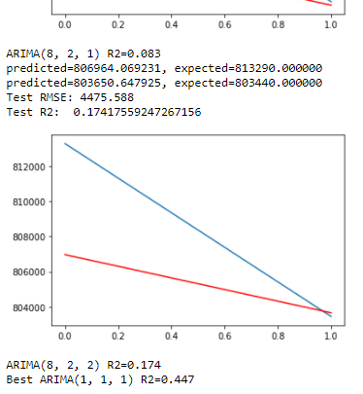
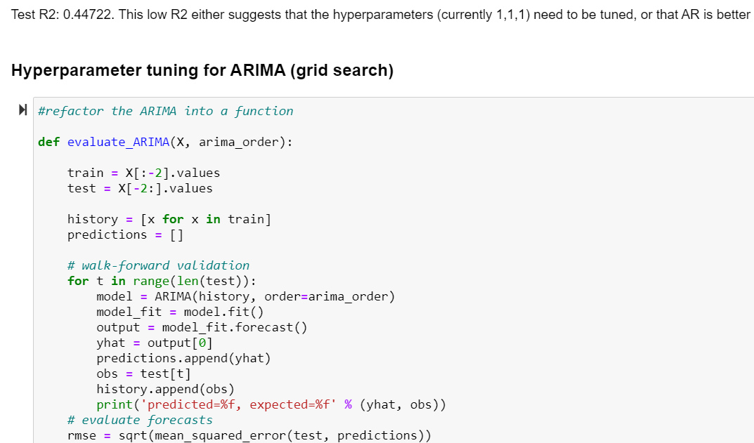
TIME-SERIES FORECASTING
6/7
Lastly, we tried ARIMA optimised with grid search hyperparameter tuning [TS7], and found that ARIMA with optimal hyperparameters is still weaker than Autoregression for our dataset.

Slide 45
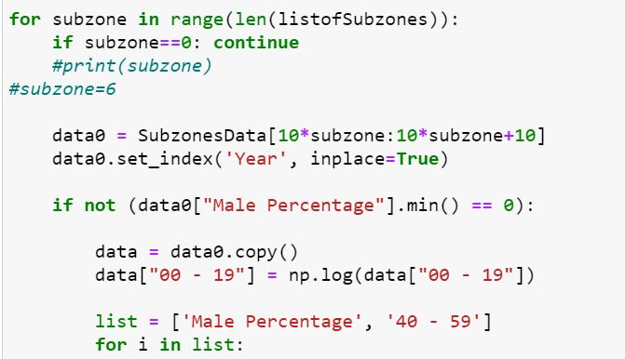
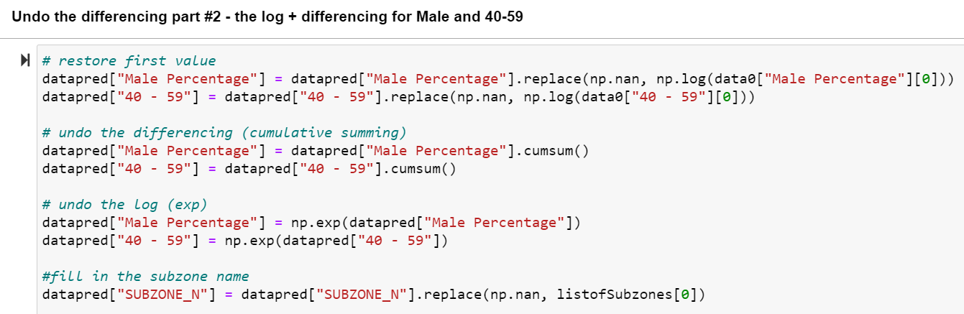
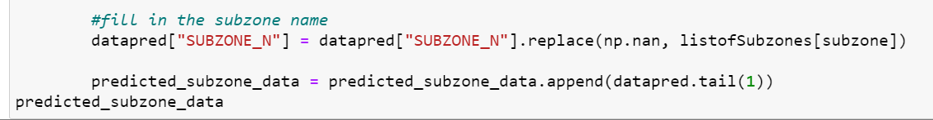
TIME-SERIES FORECASTING
7/7
We hence used autoregression with appropriate variable transformation (log / log + diff / no change) to fit the rest of the forecasting models to generate predicted subzone demographic data in 2025.
Learnt how to reverse variable transformations before exporting results (from step 6) [TS8]

Slide 46
TIME-SERIES FORECASTING
7/7
We hence used autoregression with appropriate variable transformation (log / log + diff / no change) to fit the rest of the forecasting models to generate predicted subzone demographic data in 2025.
Learnt how to reverse variable transformations before exporting results (from step 6) [TS8]

Slide 47
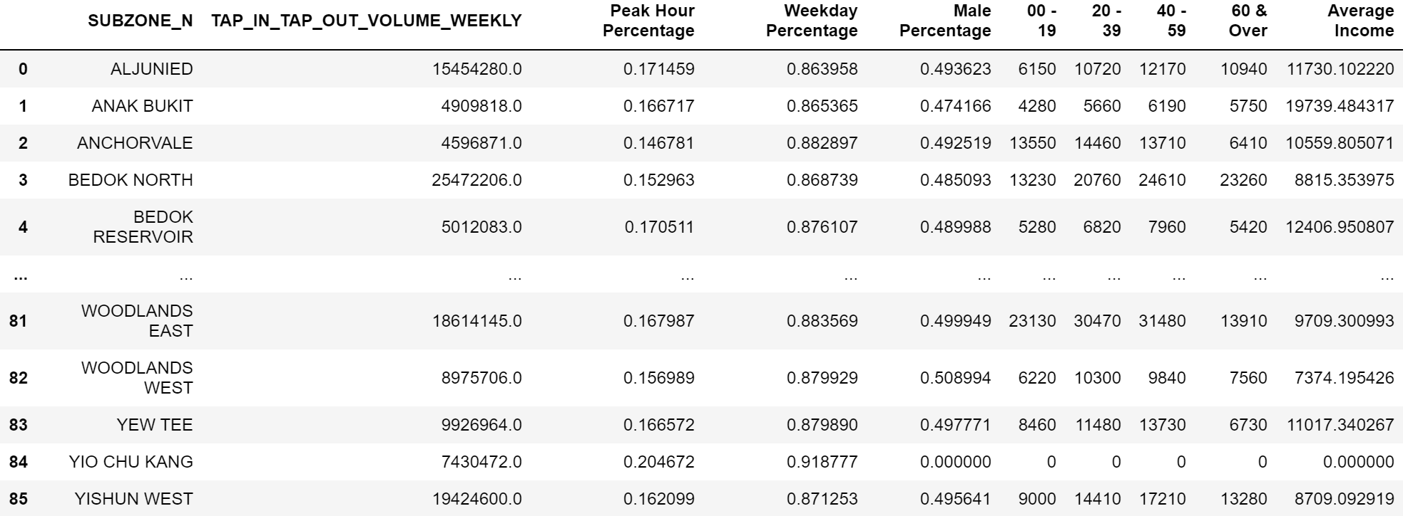
REGRESSION
1/5
Perform univariate regression by using variable in the dataset to predict weekly number of tap ins and tap out by subzone (TAP_IN_TAP_OUT_VOLUME_WEEKLY).

Slide 48
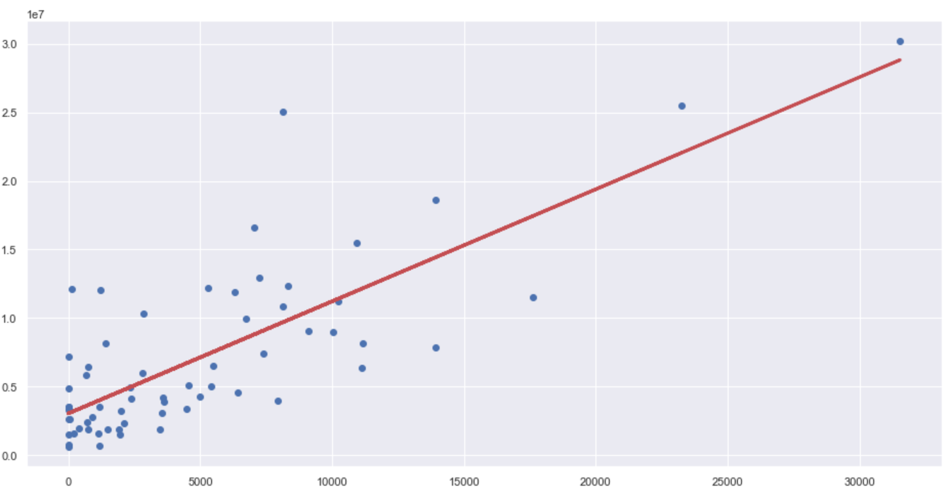
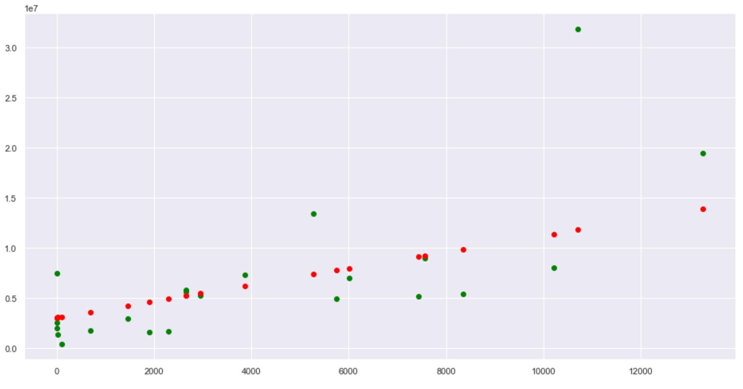
REGRESSION
2/5
Split data into train and test sets. One quarter of the data falls into the test set.
Create regression model using train data.
Apply regression model on test data.

Slide 49
REGRESSION
2/5
Split data into train and test sets. One quarter of the data falls into the test set.
Create regression model using train data.
Apply regression model on test data.

Slide 50
REGRESSION
2/5
Split data into train and test sets. One quarter of the data falls into the test set.
Create regression model using train data.
Apply regression model on test data.

Slide 51
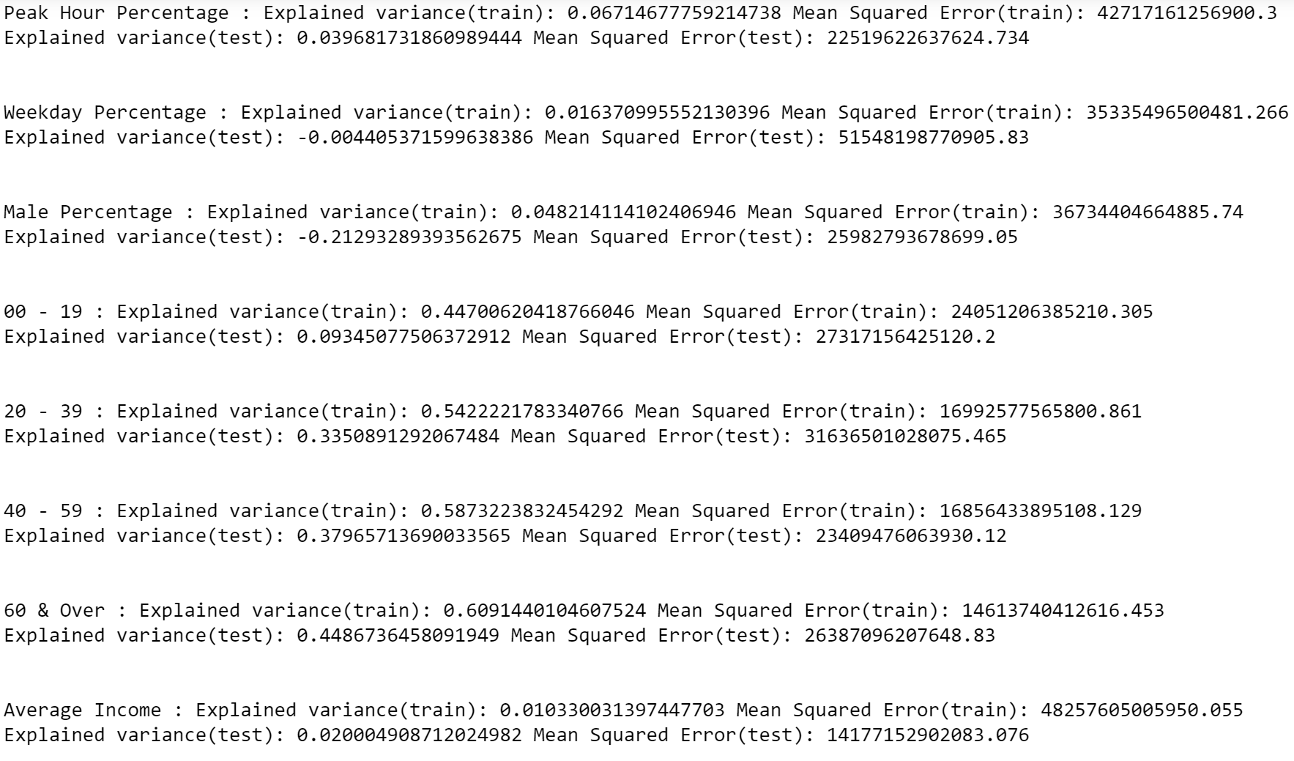
REGRESSION
3/5
Choose the six variables with the highest explained variance and lowest Mean Squared Error for our multivariate regression. They are “Peak Hour Percentage”, “0-19”, “20-39”, “40-59”, and “60 & Over” and “Average Income”.

Slide 52
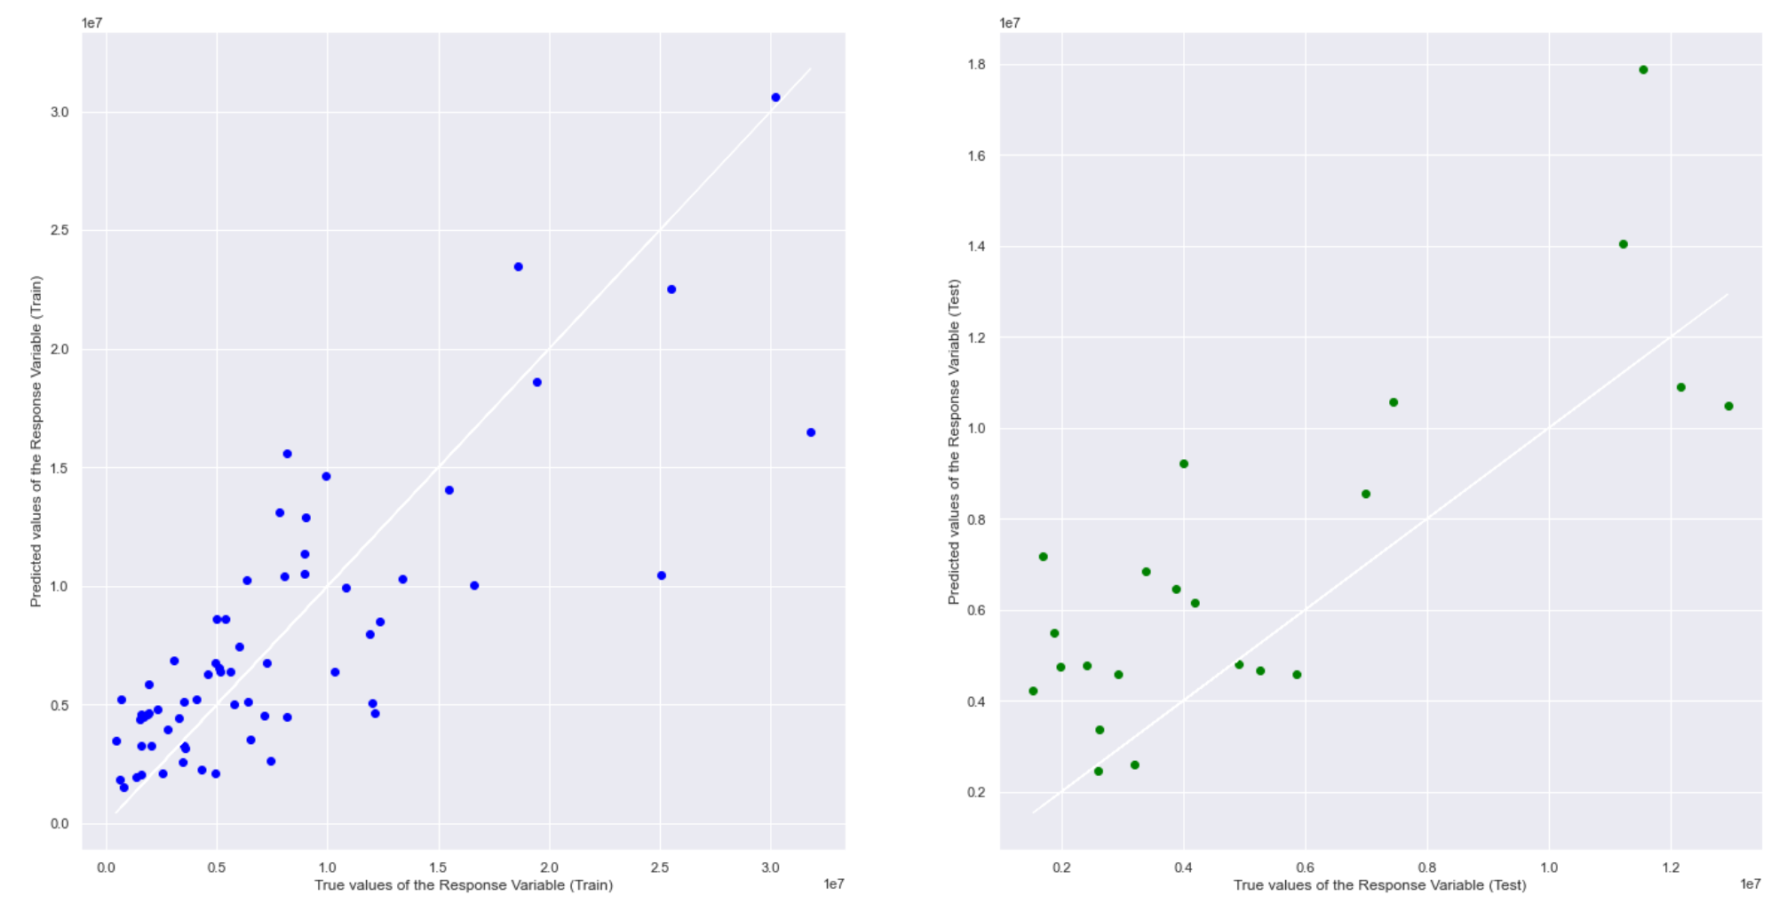
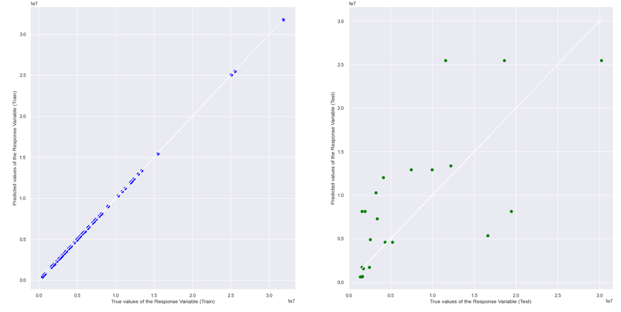
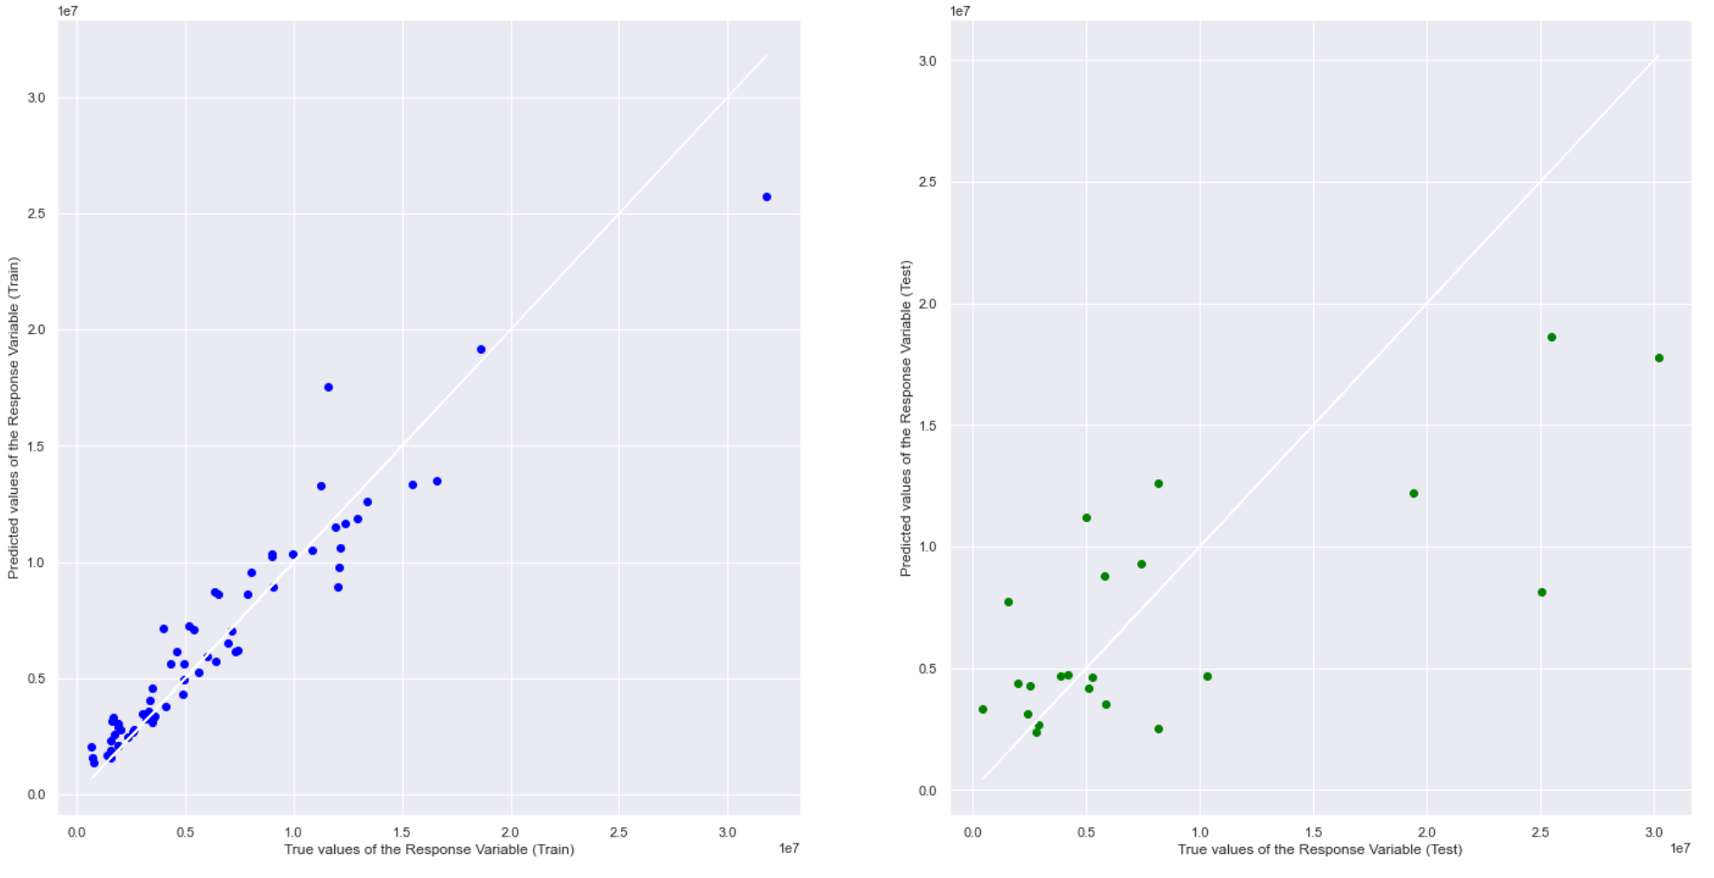
REGRESSION
4/5
Perform multivariate linear regression.
Perform decision tree regression.
Perform random forest regression.

Slide 53
REGRESSION
4/5
Perform multivariate linear regression.
Perform decision tree regression.
Perform random forest regression.

Slide 54
REGRESSION
4/5
Perform multivariate linear regression.
Perform decision tree regression.
Perform random forest regression.

Slide 55
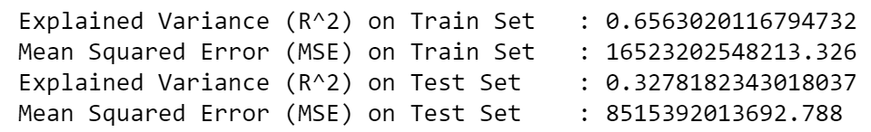
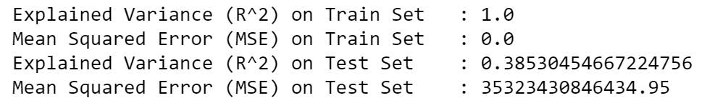
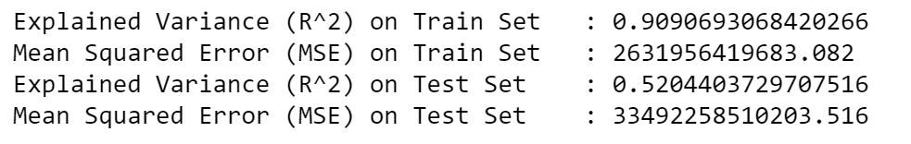
REGRESSION
5/5
Compare explained variance of the models to determine that the random forest regression is the most accurate in predicting weekly tap ins and tap outs.
Multivariate linear regression
Decision tree regression
Random forest regression

Slide 56

CONCLUSION
Outcome | Data-driven Insights

Slide 57
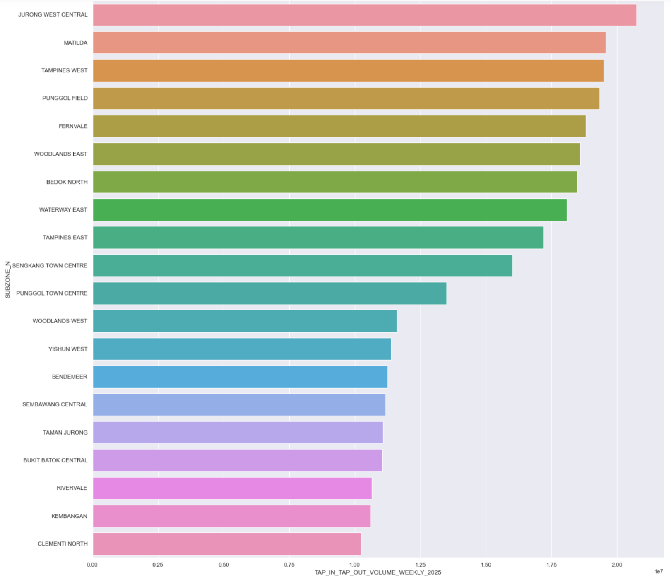
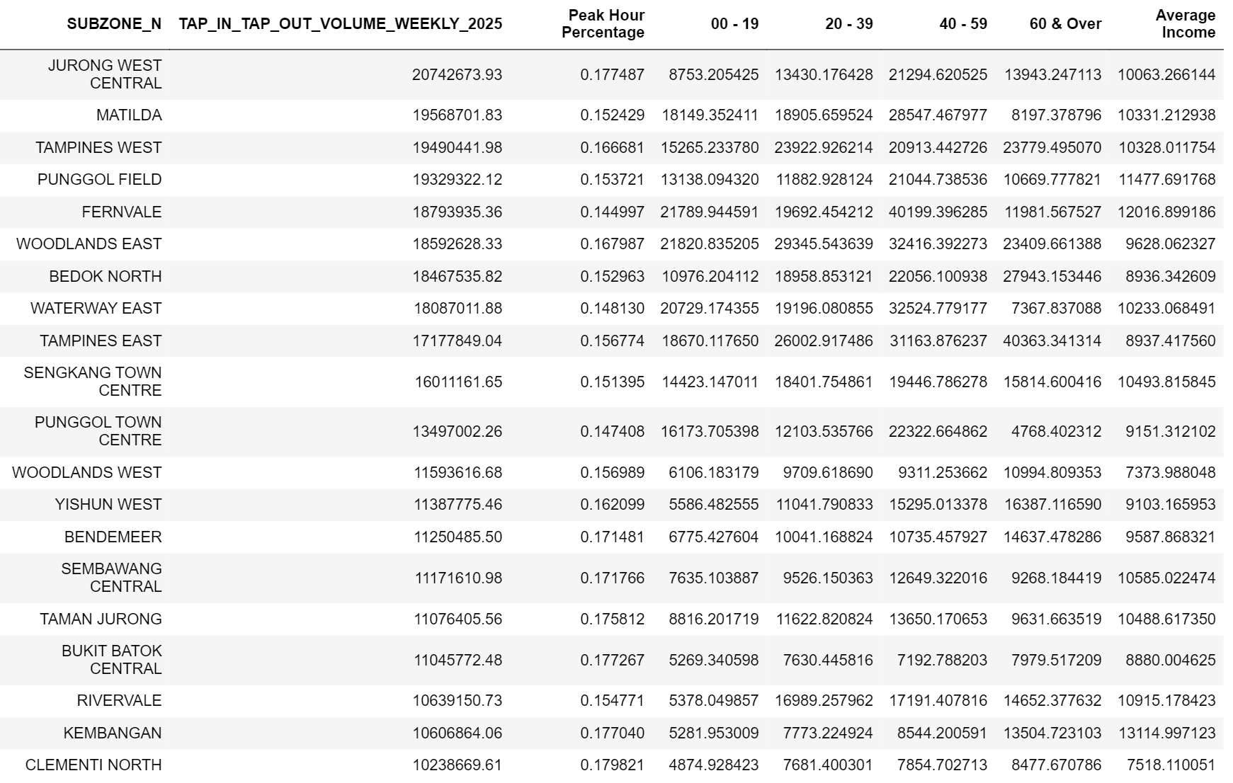
Data-Driven Insights
1/6

Slide 58
Data-driven Insights
1/6

Slide 59
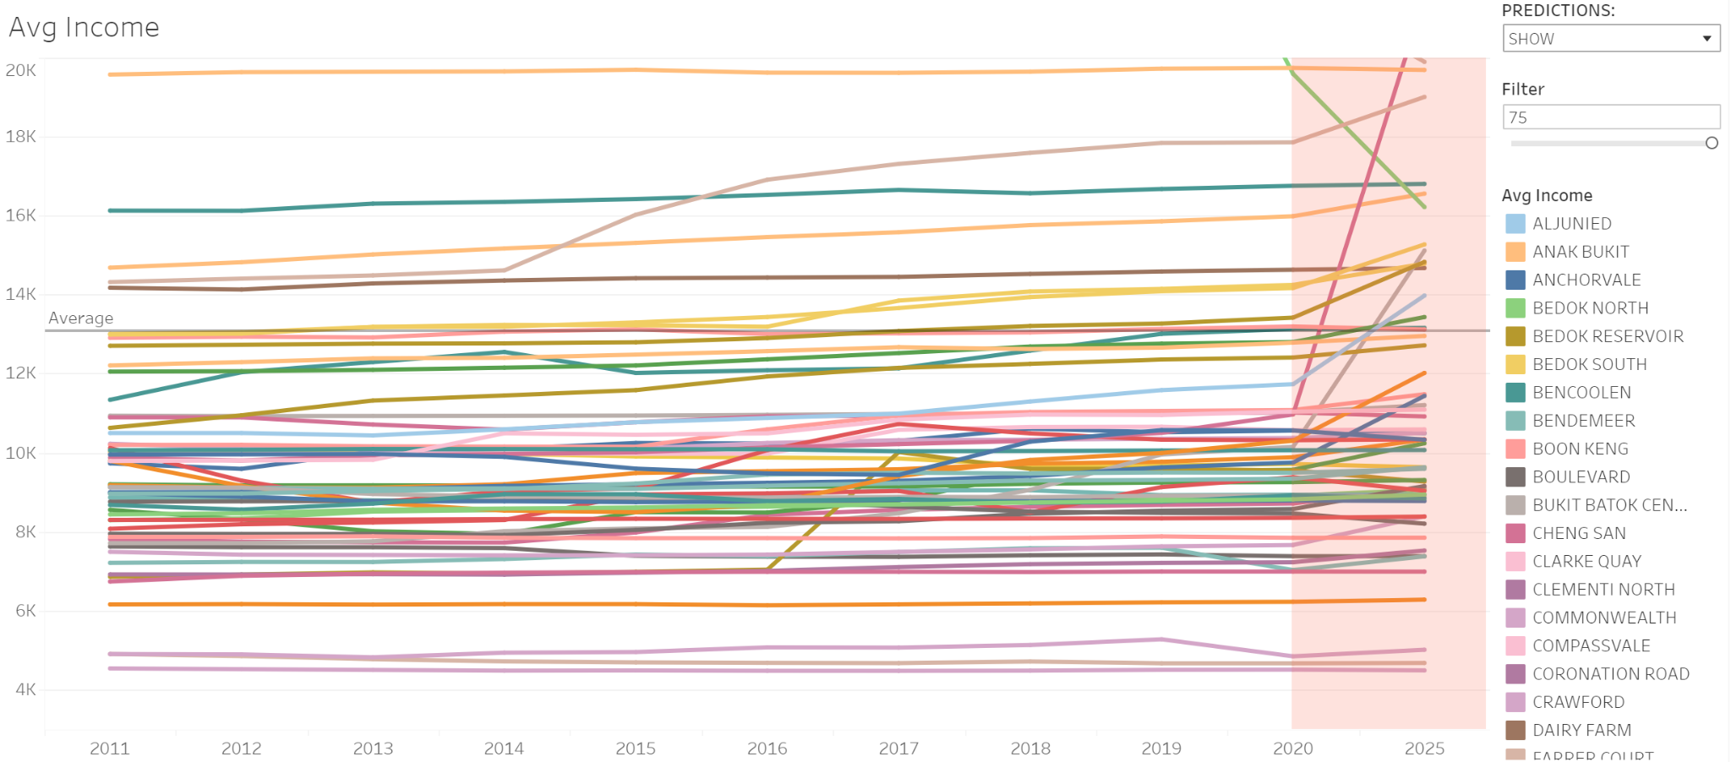
DATA-DRIVEN
INSIGHTS
2/6
Average Income by Subzone

Slide 60
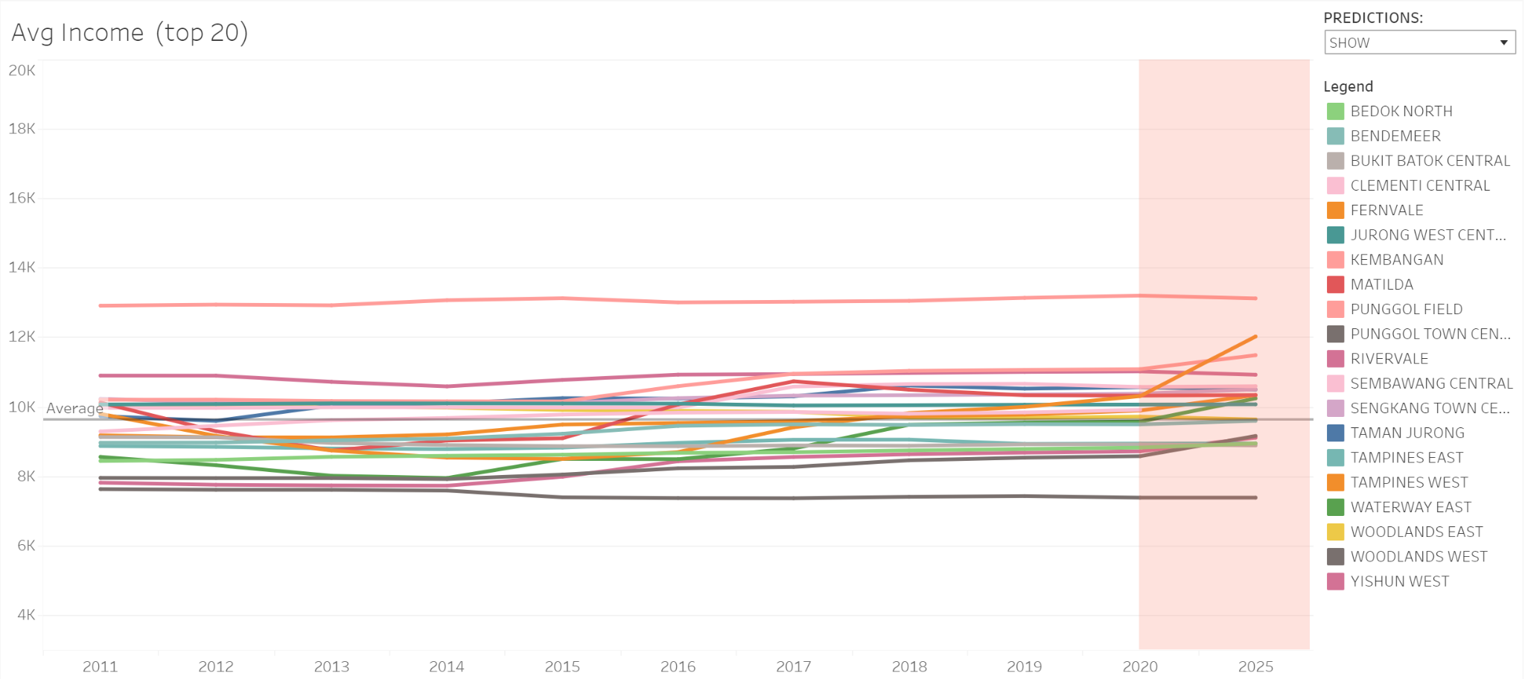
DATA-DRIVEN
INSIGHTS
3/6
Average Income by Subzone (top 20)

Slide 61
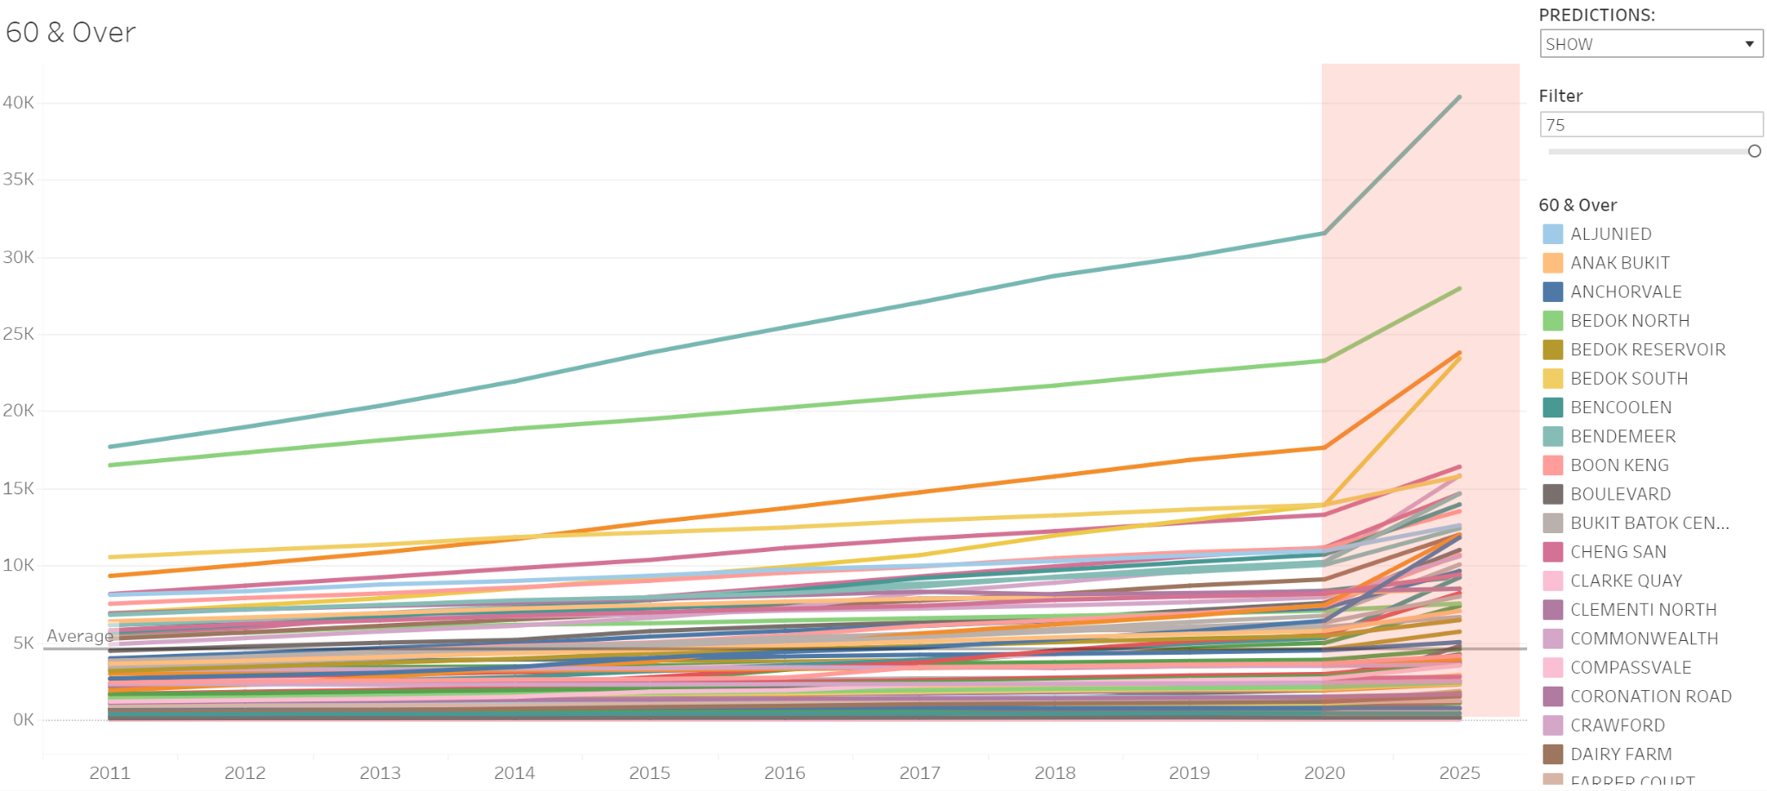
DATA-DRIVEN
INSIGHTS
4/6
60 & Over by Subzone

Slide 62
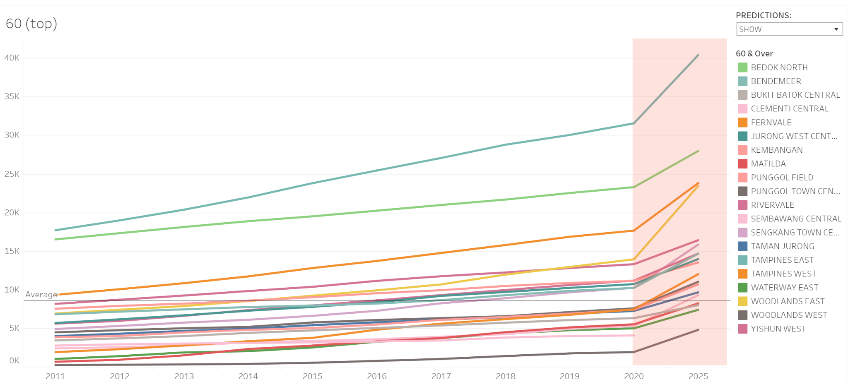
DATA-DRIVEN
INSIGHTS
5/6
60 & Over by Subzone (top 20)

Slide 63
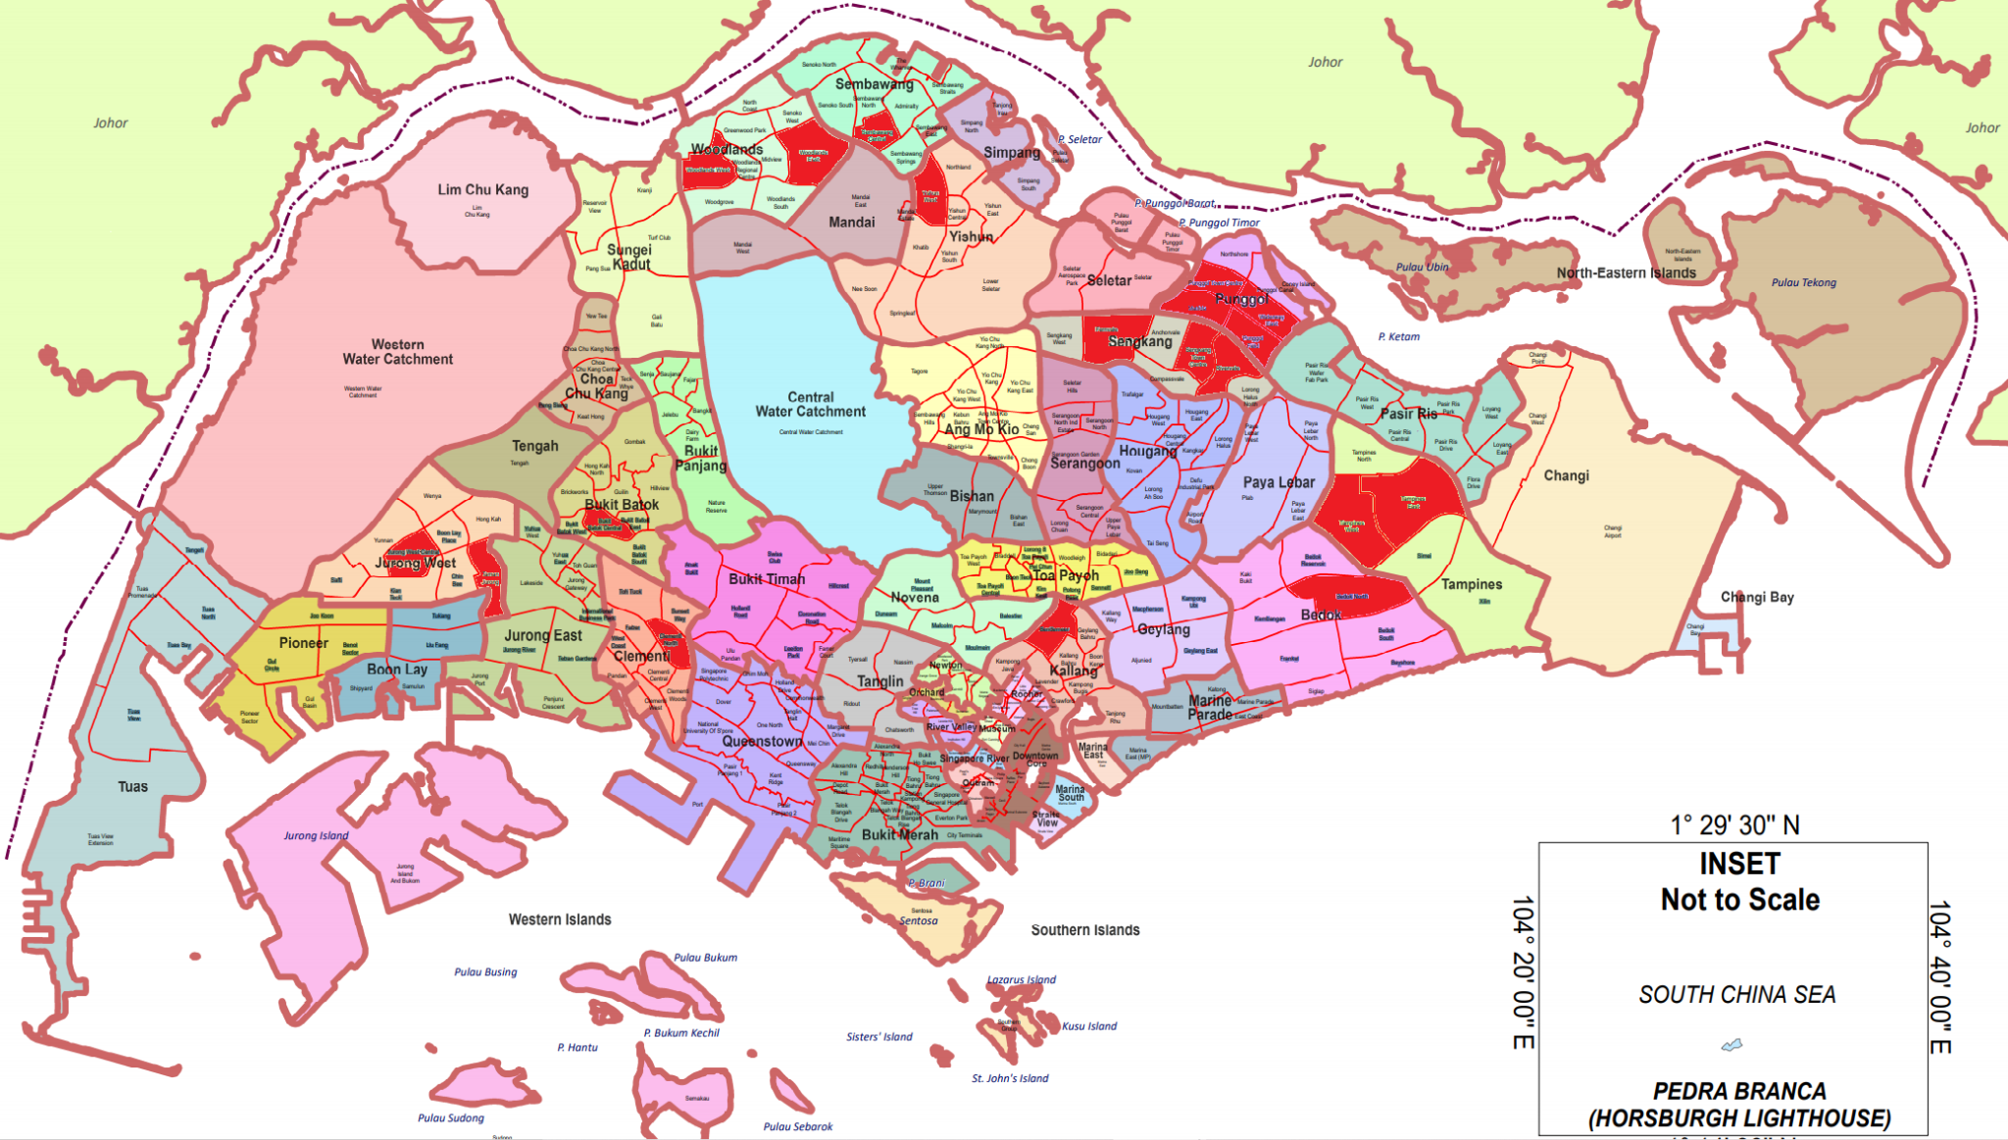
DATA-DRIVEN
INSIGHTS
6/6

Slide 64
OUTCOME
Where should new MRT/bus stops be built to alleviate traffic?

Slide 65
REFERENCEs
Graphics, images from flaticon.com, freepik.com and slidesgo.com
[DC1] DataMall API User Guide & Documentation. https://datamall.lta.gov.sg/content/dam/datamall/datasets/LTA_DataMall_API_User_Guide.pdf
[DC2] Dealing with categorical variables https://www.analyticsvidhya.com/blog/2015/11/easy-methods-deal-categorical-variables-predictive-modeling/
[DC3] Turn row duplicates into column headers https://stackoverflow.com/questions/65399747/turn-rows-duplicates-into-columns-headers
[DC4] Merging and joining dataframes https://www.shanelynn.ie/merge-join-dataframes-python-pandas-index-1/
[DC5] Confounding variables https://www.scribbr.com/methodology/confounding-variables/
[DC6] Collinearity in regression https://www.algosome.com/articles/dummy-variable-trap-regression.html
[DC7] .multiindex https://pandas.pydata.org/pandas-docs/stable/reference/api/pandas.MultiIndex.html
[DC8] Adding new column https://www.geeksforgeeks.org/adding-new-column-to-existing-dataframe-in-pandas/
[DC9] .loc https://pandas.pydata.org/docs/reference/api/pandas.DataFrame.loc.html
[DC10] Flattening hierarchical indexes https://stackoverflow.com/questions/14507794/pandas-how-to-flatten-a-hierarchical-index-in-columns
[DC11] Panda’s .concat https://pandas.pydata.org/docs/reference/api/pandas.concat.html
[DC12] Convert to datetime https://stackoverflow.com/questions/17134716/convert-dataframe-column-type-from-string-to-datetime-dd-mm-yyyy-format
[DC13] Peak hour timings https://data.gov.sg/dataset/road-traffic-conditions
[TS1] Vector Autoregression, Granger’s Causality Test https://www.machinelearningplus.com/time-series/vector-autoregression-examples-python/
[TS2] Setting column as dataframe index https://pandas.pydata.org/docs/reference/api/pandas.DataFrame.set_index.html
[TS3] Backtesting for time-series forecasting https://machinelearningmastery.com/backtest-machine-learning-models-time-series-forecasting/
[TS4] Lag plots https://www.statisticshowto.com/lag-plot/
[TS5] Why stationarity matters, Augmented Dickey-Fuller https://towardsdatascience.com/why-does-stationarity-matter-in-time-series-analysis-e2fb7be74454
[TS6] Removing trends and seasonality difference https://machinelearningmastery.com/remove-trends-seasonality-difference-transform-python/
[TS7] ARIMA with grid search hyperparameters https://machinelearningmastery.com/grid-search-arima-hyperparameters-with-python/
[TS8] Reversing variable transformations https://stackoverflow.com/questions/59922291/how-to-reverse-a-seasonal-log-difference-of-timeseries-in-python
[R1] Decision tree regression https://levelup.gitconnected.com/decision-tree-regression-df9e24ffe59a
[R2] Random forest regression https://levelup.gitconnected.com/random-forest-regression-209c0f354c84
Map https://www.singstat.gov.sg/-/media/files/publications/population/population2018-map1.pdf
Interactive Tableau dashboards https://help.tableau.com/current/pro/desktop/en-us/parameters_create.htm
ARIMA in Tableau https://towardsdatascience.com/forecasting-with-python-and-tableau-dd37a218a1e5

Slide 66
MEMBER’S
CONTRIBUTIONS
THE|PATHFINDERS
Members | Contributions
Jeremy Tan | Data Engineer (extraction of dataset 1) Business Intelligence Analyst (exploratory analysis)
Bryan Leow | Software Engineer (time-series forecasting) Business Intelligence Analyst (exploratory analysis)
Lim Shi Han | Data Engineer (extraction of dataset 2) Software Engineer (regression modelling)
SPECIAL|THANKS
Prof Lin Feng | Professor In-Charge, FSP5
Zhang Haosong | TA, FSP5

Slide 67
FSP 5, TEAM 7
TAN JEREMY
THE|PATHFINDERS

Slide 68
FSP 5, TEAM 7
LEOW BRYAN
THE|PATHFINDERS

Slide 69
FSP 5, TEAM 7
LIM SHI HAN
THE|PATHFINDERS

